Slide 1

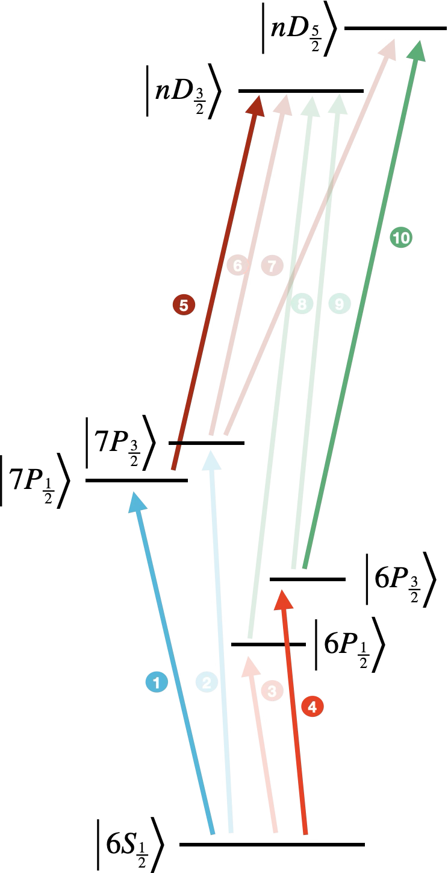
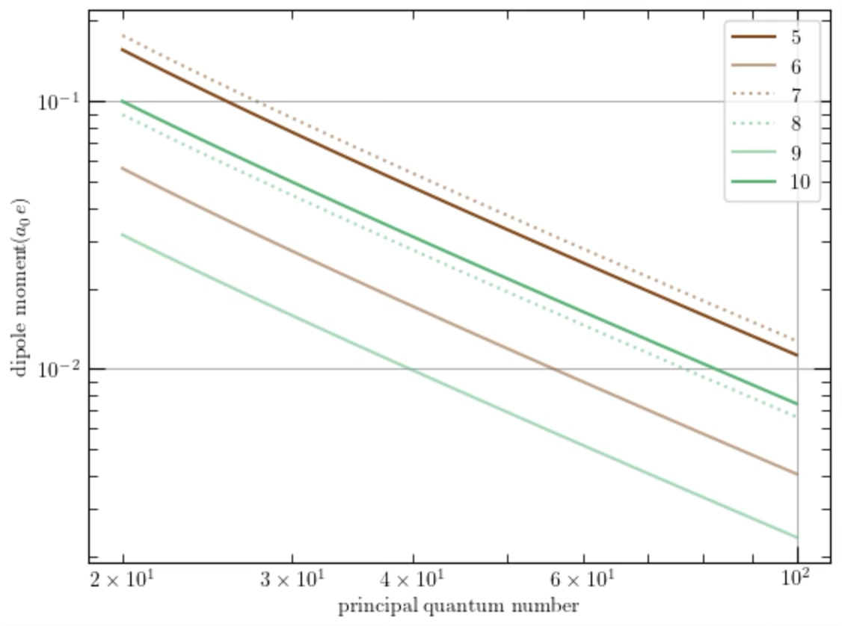
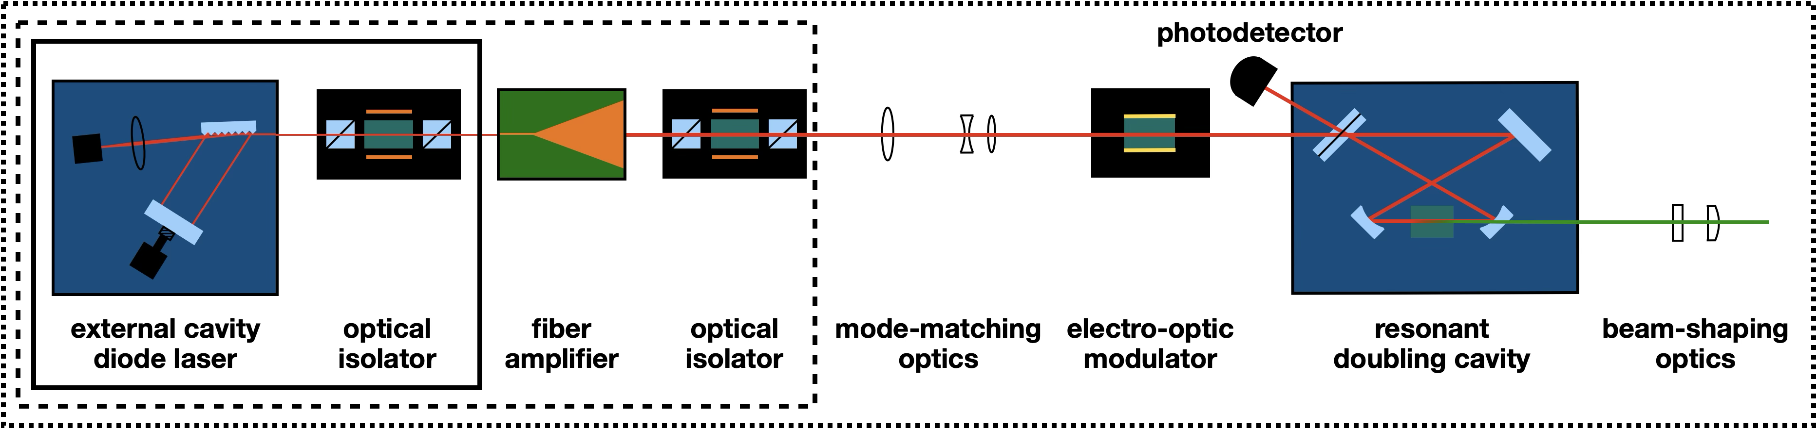
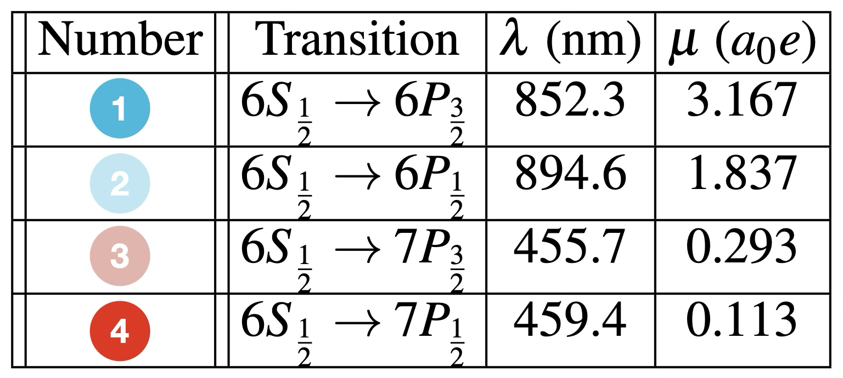
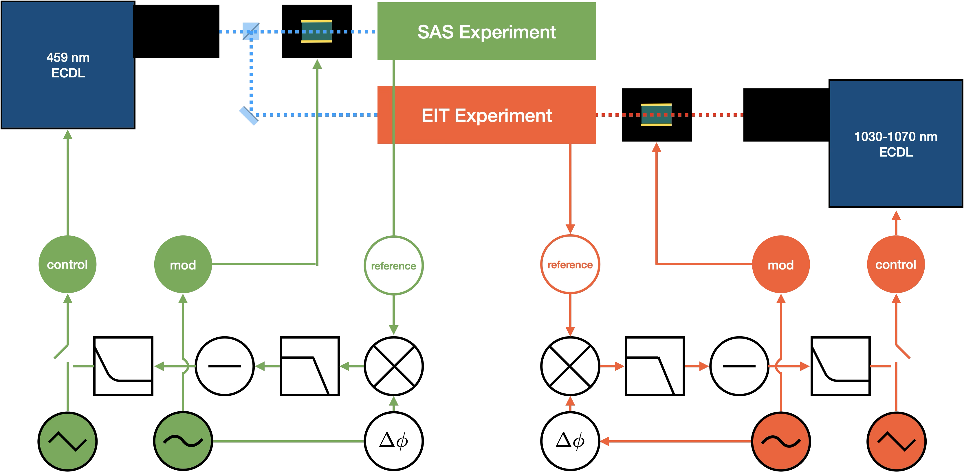
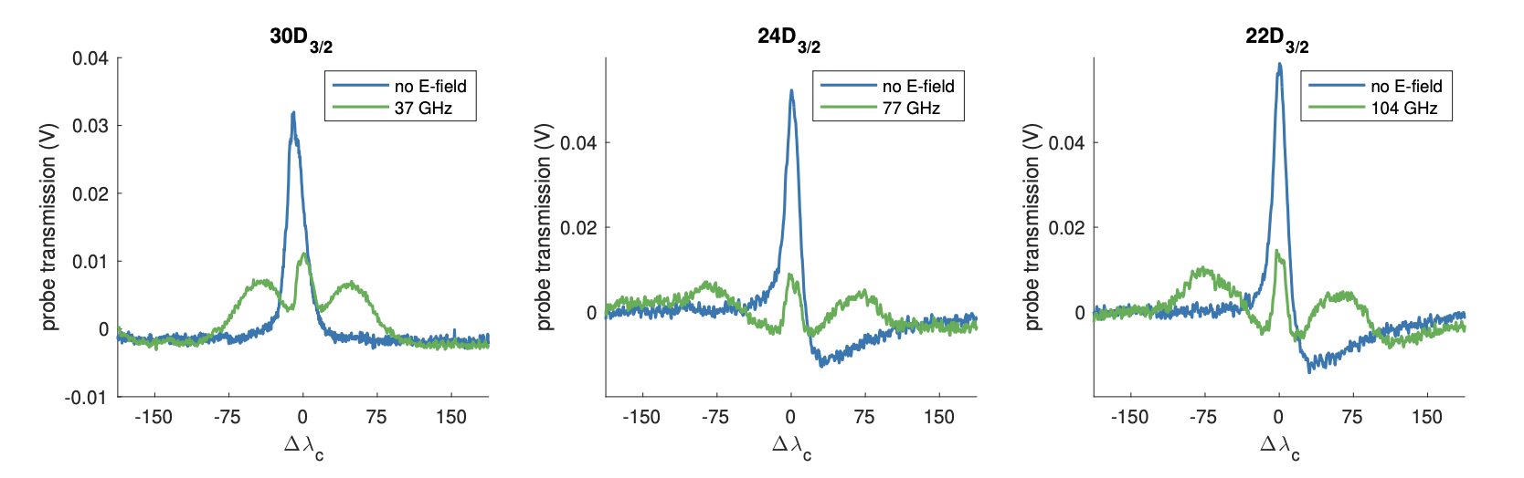
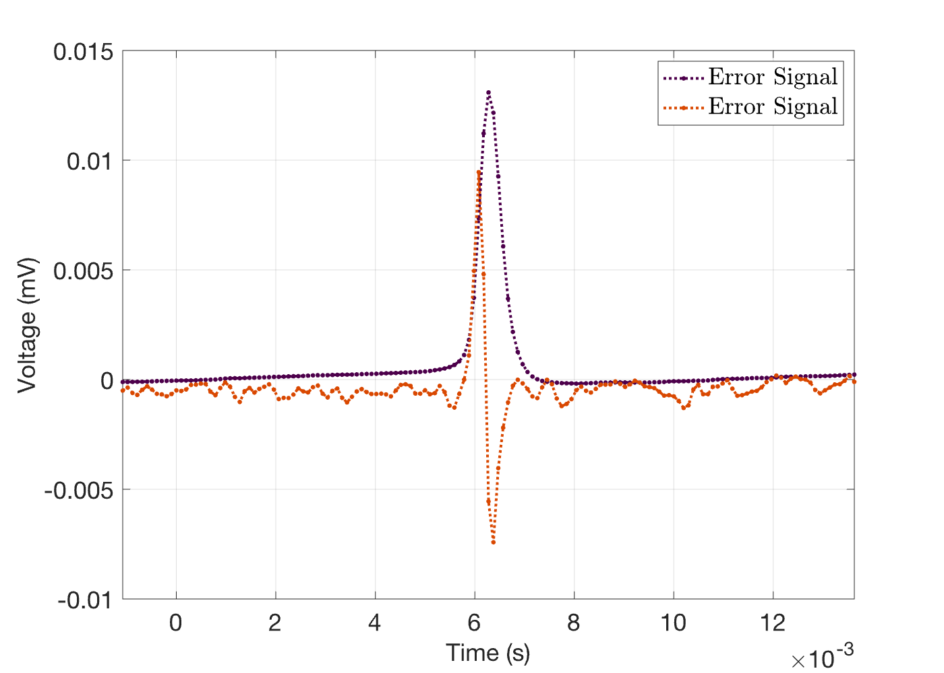
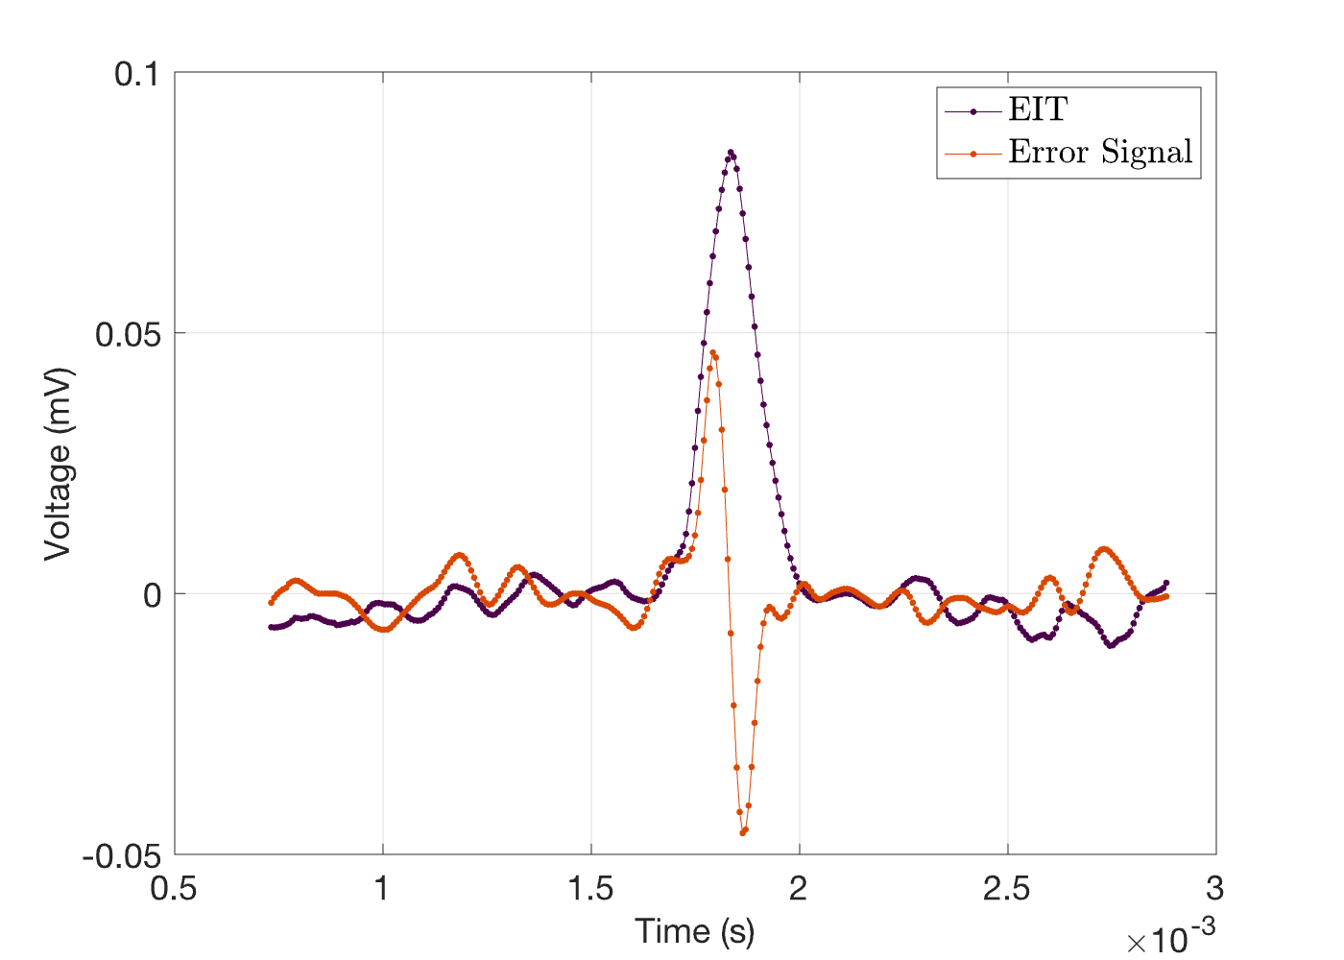

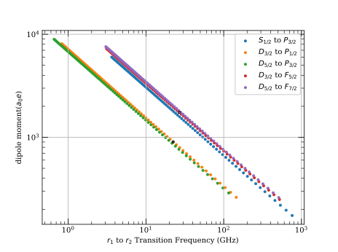
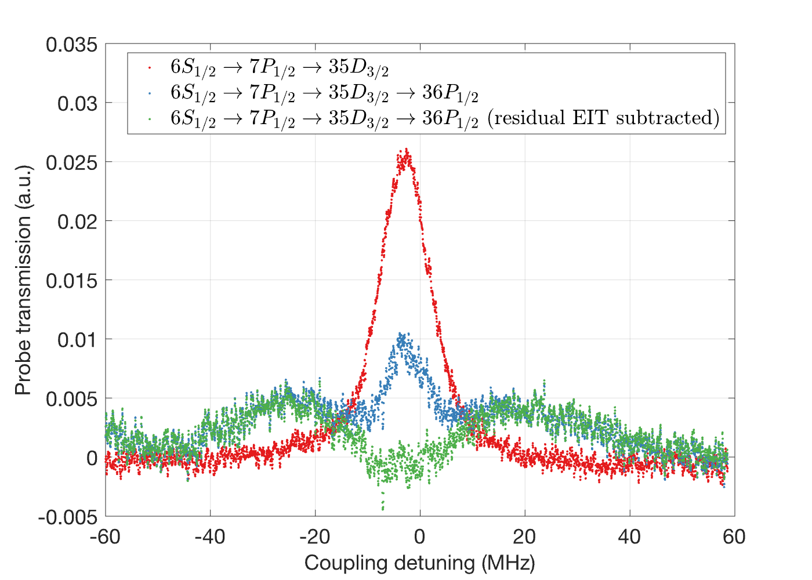
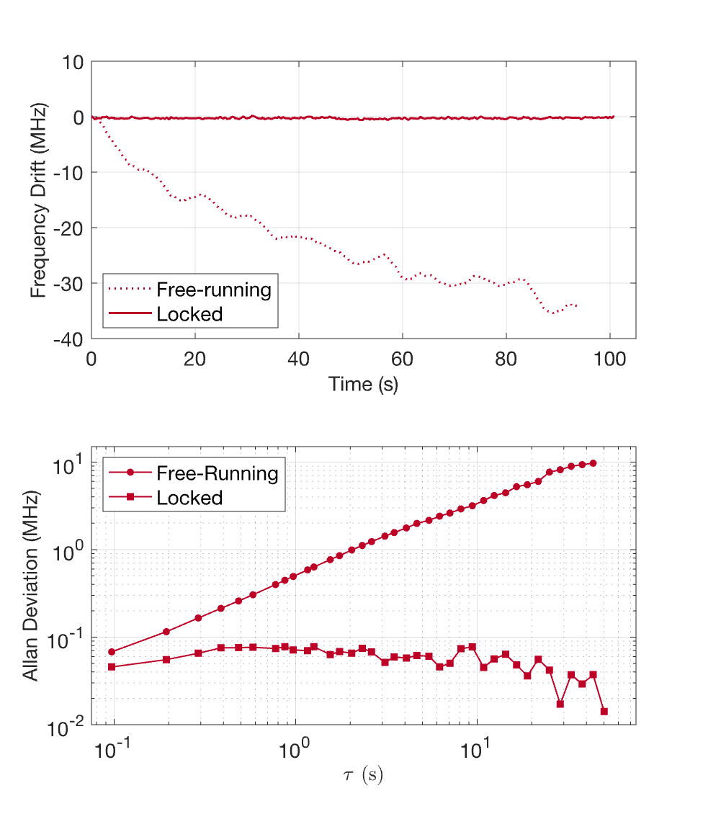
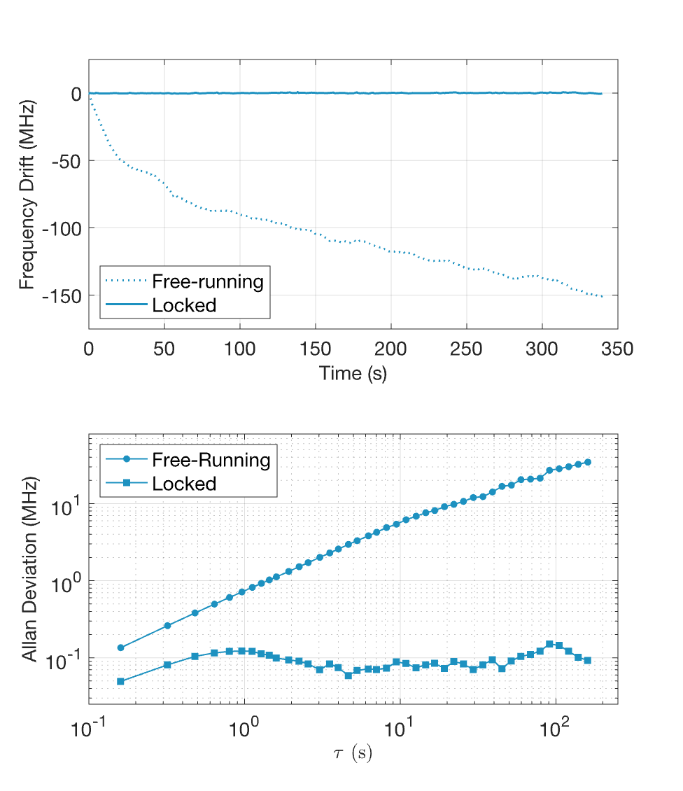
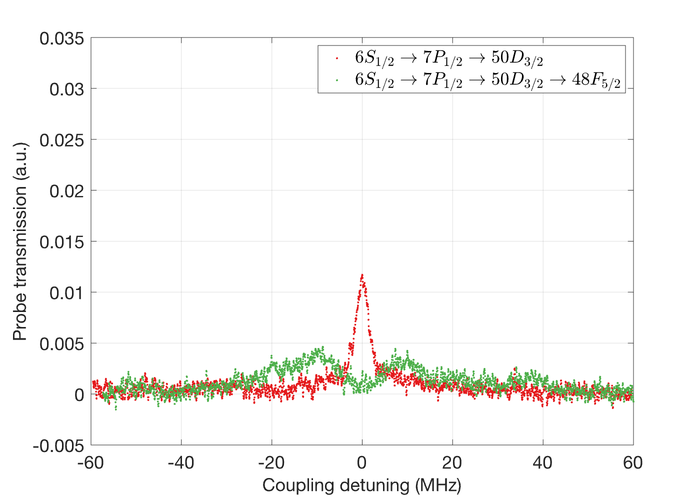
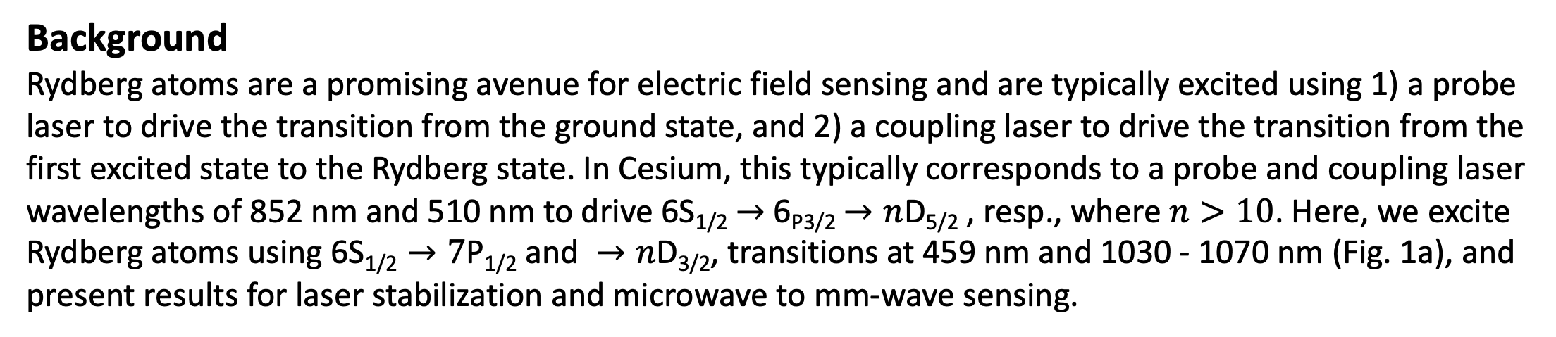
National Aeronautics and Space Administration
Postdoc Research
Electric-Field Sensing and Laser Stabilization with Rydberg Atoms Excited through the 7P_{1/2} State
Author: Devin Willey (334G, JPL Postdoctoral Fellow), Darmindra Arumugam (334G, Technologist)
Background
Rydberg atoms are a promising avenue for electric field sensing and are typically excited using 1) a probe laser to drive the transition from the ground state, and 2) a coupling laser to drive the transition from the first excited state to the Rydberg state. In Cesium, this typically corresponds to a probe and coupling laser wavelengths of 852 nm and 510 nm to drive 6S_{1/2} $→$ 6_{P3/2} $→n$D_{5/2} , resp., where $n>10$. Here, we excite Rydberg atoms using $\text{6}\text{S}\text{1/}\text{2}→7\text{P}\text{1/}\text{2} \text{and} →n\text{D}\text{3/}\text{2}$, transitions at 459 nm and 1030 - 1070 nm (Fig. 1a), and present results for laser stabilization and microwave to mm-wave sensing.
a)
c)
b)
Fig. 2: Laser system used in this work to generate telecom wavelengths (solid line), SHG (dotted line) to generate 510 nm, and an intermediate system with equivalent power output (dashed line).
Fig. 1: Atomic transitions (a) and their corresponding dipole moments (b,c).
Objectives
These transitions were chosen to explore alternatives to the 510 nm wavelength: given optical power and laser linewidth requirements for Rydberg sensing applications, 510 nm laser architectures often employ second harmonic generation (SHG) through an optical cavity (Fig. 2), which leaves the system susceptible to mechanical vibrations. By using longer wavelengths in the telecom range, the laser architecture could be made simpler and more robust to vibration.
a)
Approach and Results
The coupling laser dipole moments for the coupling transition scale favorably, in contrast to those of the probe transition (Fig. 1b), therefore requiring the cell to be heated to 80° C to increase the atomic density. The probe laser was locked to the F = 4 to F = 3 hyperfine transition using a saturated absorption spectroscopy (SAS) configuration, while the coupling laser was scanned over electromagnetically induced transparency (EIT). The probe and coupling laser light were modulated using an electro-optic modulator (EOM), thereby generating a zero crossing when demodulated (Fig. 3). The stabilized probe and coupling laser frequencies varied <1 MHz over >90 s and had Allan deviations of < 200 kHz (Fig. 4). Mm-wave (Fig. 5) and microwave (Fig. 6) sensing results are achieved through Autler-Townes (A-T) splitting of EIT.
b)
Hyperfine
c)
Fig. 5: EIT and A-T splitting shown for Rydberg transitions 30D_{3/2} → 31P_{1/2} (left), 24D_{3/2}→ 25P_{1/2} (center), and 22D_{3/2} → 23P_{1/2} (right). A high-pass filter was used in the center and rightmost experiments, causing an asymmetry in the EIT and A-T splitting features.
Fig. 3: Laser stabilization block diagram (a), hyperfine (b) frequency reference and error signal, and EIT frequency reference and error signal (c).
Significance of Results/Benefits to NASA/JPL
Exploring alternative Rydberg excitation schemes helps to identify feasible pathways toward more compact and ruggedized E-field sensing, as well as employ simpler laser architectures that enable rapid coupling laser tuning to take advantage of the broadband response of the atoms to sense frequencies from kHz to THz.
Future Work
Some limitations of this excitation scheme include the requirement that the cell be heated to increase the atomic density: foil was used to improve homogeneity of the temperature throughout the cell, making the setup sensitive to the direction of the incoming electric fields. Higher temperatures and a different heating geometry could improve the sensitivity of the atoms to incoming fields. Additionally, a mechanical resonance of the tuning mechanism of the probe laser introduced a strong 5 kHz noise source into the probe laser light, which limited the sensitivity of the setup and necessitated filtering in the laser stabilization signal processing chain.
Fig. 6: Rydberg-Rydberg dipole moments versus transition frequency (a) and A-T splitting results for microwave frequencies of D to P (b) and D to F (c) transitions.
Publications and Acknowledgements:
D. Willey, D. Arumugam. Electric field sensing with Rydberg atoms excited through the 7P1/2 state. NRSM 2026; Boulder CO. (Abstract)
D. Willey, D. Arumugam. Electric field sensing and laser stabilization with Rydberg atoms excited through the 7P1/2 state. (In preparation)
Author Contact Information:
devin.a.willey@jpl.nasa.gov, 540-467-7455
Clearance Number: CL#00-0000
Poster Number: Postdoc-T-016
Copyright 2024. All rights reserved.
National Aeronautics and Space Administration
Jet Propulsion Laboratory
California Institute of Technology
Pasadena, California
www.nasa.gov
Fig. 4: Laser drift (top) and Allan deviation (bottom) of the probe (left) and coupling laser (right) when locked (solid lines and square markers) and free running (dashed lines and circle markers).

